Slide 1
Transparency intermedia module 3 : Applying technological concepts

Slide 2
Why is XAI important?
In order to understand our explainability requirements we need to remind ourselves of what we are trying to achieve.
Build tools to augment the end users understanding of the situation and assist them in their decision-making process – augment and assist NOT automate
Tools must be transparent, understandable and explainable to the end user, if they are to effectively incorporate the outputs to help their assessment
Understanding how a tool produced a result allows the end user to effectively assess how that result fits in with their professional assessment

Slide 3
Requirements gathering
The key question to gather requirements:
What does the end user need to know about the insight to be able to trust, understand, and make decisions?
The answer to this question will depend on three things:
Who the end user is – what level of technical understanding or interest do they have?
What insight is being provided – is it a probability from a classification model? Is it a network visualisation? Is it the binary results of a text classifier? Has there been a lot of data manipulation?
How that insight is operationalised – how are they going to use the insight to help them make a decision?

Slide 4
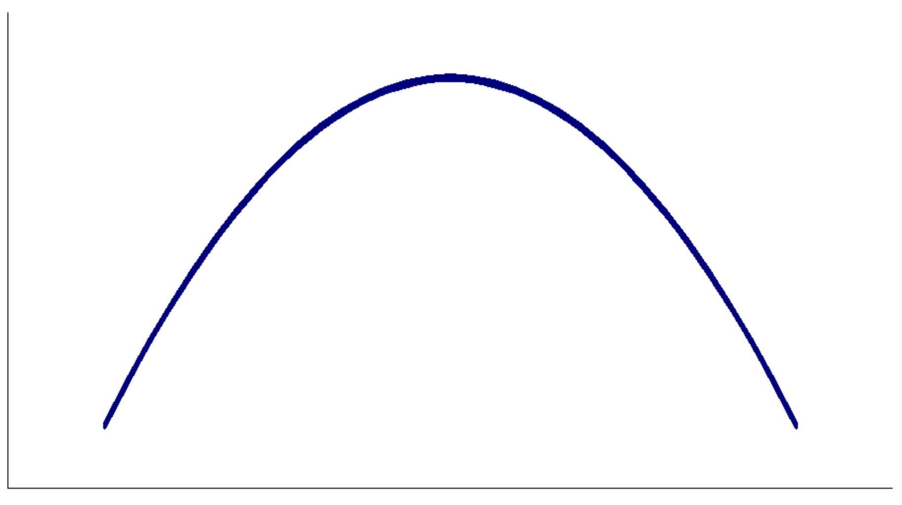
Who is the end user?
The optimal level of detail will depend on who the end user is
It is important to understand your audience and what level of technical understanding they have
Questions to consider:
How techincal is the end user?
Are they familiar with certain types of data presentation in their current work? Do they use percentiles, bar graphs, scatter plot? If not, perhaps text is the most effective.
Do they need to know how the model works or just what the results mean?
Effectiveness of explainability
Not enough information to understand or trust the insights
Overwhelming - too much information means the user does not engage
Level of detail

Slide 5
What insight is being provided?
What data is being used in the model? Is the end user familiar with the data? How much context needs to be provided?
What model is being used? Is it a probability from a classification model? Is it a network visualisation? Is it the binary results of a text classifier? This will affect how you present the insights
How good is the model?
What are the limitations of the results? What do they not take into account?

Slide 6
How is the insight operationalised?
How much time is the end user going to have to look at the results?
Is the end user trying to make comparisons? Or isolated decisions? Or just gain some context?
Is it as part of an application or dashboard? If so, you will need to think about the design, e.g., positioning of insights, prominence of information, colours used, presenting a narrative etc. Design of AI systems is beyond the scope of this course

Slide 7
Model Evaluation: Performance
We don’t simply want to follow well-known paradigms but perform instead a critical evaluation:
Which metrics are available for the task my model ought to solve?
Which performance to prioritise, given the specificity of the problem?
Maximising precision or recall? Or a combination of both?
Which trades-off am I willing to accept?
What is a “good enough” (define a threshold) performance for my problem?
Consider bias! How does the performance change for groups within the population? [more on this in the fairness module]
Not just one, but a range of metrics for a more comprehensive assessments

Slide 8
Model Evaluation: Beyond Performance
Performance numbers alone don’t tell the whole story!
Why the model achieved that performance and made certain inferences?
Need for model explainability
Before jumping on explainability implementations, identify requirements:
How much explanation my model requires in the first place?
What do I need to explain and why?
Which granularity of explanation is required?

Slide 9
Explainability needs by model type
White box
Simpler models
Linear regression, decision trees, rule-based etc.
Observable and understandable input-output relation
Black box
Complex models, with many parameters
Deep learning models
Unobservable input-output relation
Require several metrics to try to capture different aspects of the model inner working
Low explainability needs, explanation relies on inner model parameters
Several explainability metrics are model-agnostic and can potentially be applied to both white and black box models, other are specific to one of the two categories or to a specific model (model-specific).

Slide 10
Reasons for explanation
The choice of the explainability metrics should also be guided by questions around what I want or need to communicate to stakeholders. Some common use cases:
Biases in the predictions
Importance of different model features
Correlations among features
Insights on causal relations
How changes in inputs affect model performance outputs (sensitivity analysis)
Explanations are also useful for developers to more easily spot unexpected model behaviours and identify corrective action!

Slide 11
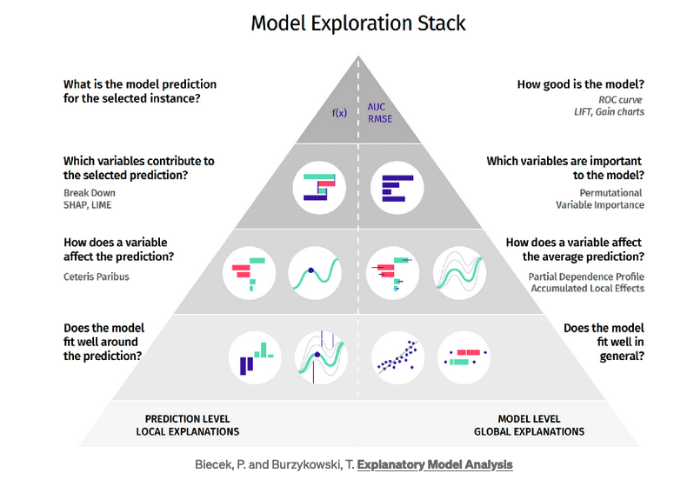
Granularity of explanation

Slide 12
Explainability and justifiability
The goal of justification is to convince that a decision is “good” or appropriate.
Though related, justifiability and explainability are different: we can understand how a model produced certain outputs, but we might not think these outputs are good (and vice versa).
As with explainability, justifiability of a model output can be provided at global or local level.
The assessment of whether a model outcome is good lies outside the algorithmic development, however, explainability metrics provide useful means to experts and decision makers to make this assessment.

Slide 13
Explainability and accountability
When a model makes a ‘wrong’ (e.g., harmful) decision, it is important to know who should be accountable for this; this is a non-technical decision, however, explainable metrics can help identifying what caused the failure and to correct the errors.
Technical considerations to make when investigating model performances to support the justifiability and accountability assessment include:
Documenting each step of model development, from input data collection to output delivery
Understanding and communicating biases and limitations of the model
Making the model outputs reproducible to external users
Assuring compliance with best coding practices in the developers' team
Performing extensive technical testing of the model
Considering cyber-security requirements
Establish a data governance approach, so that these steps are carried out continually and iteratively

Slide 14
Indicator Types
Exploratory data analysis
Feature Importance
Model performance monitoring
Model explainability
Bias
Notes:
In this section, we aim to provide an overview of what indicators are available to quickly diagnose various aspects of your data and model. We categorise indicators into five categories. These include:
Exploratory data analysis indicators: Here we look at what indicators are available to get a quick understanding of your data and associated distributions. Exploratory data analysis is a very broad topic, and indicators vary depending upon specific use cases. We focus on some generic techniques in a supervised context, that can quickly give an understanding of your data.
Feature Importance: This looks at indicators that identify what features in your dataset might be important for your model to make decisions.
Bias: Bias can be on many different levels, here we talk about biases associated with model generalisation that seek to avoid stereotypical harms, for example, a model you train should be fair on all cohorts of your population.
Model performance monitoring:
This deals with a collection of metrics once a model has been trained to evaluate model performance on unseen test instances.
In addition to this, this also includes a series of metrics that capture data drifts and target variable drifts once a model has been launched in production.
This also includes indicators to compare predictions of re-trained models on new test instances with existing (benchmarked) model that has previously worked well in production.
Model Explainability: Indicators here deal with explaining the predictions of a machine learning model once the model has been trained. A model maybe accurate but it maybe accurate for the wrong reasons. It is important to understand model behaviour to explain why a model makes certain decisions and also address associated biases and limitations on areas where generalisation is poor. Explainability also helps to develop trust/confidence with various stakeholders associated with the project.

Slide 15
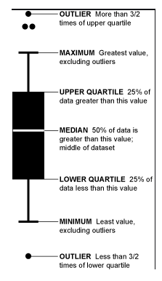
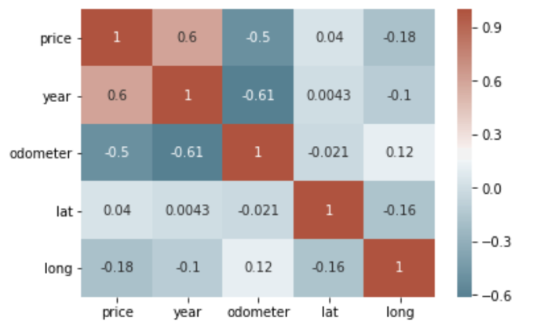
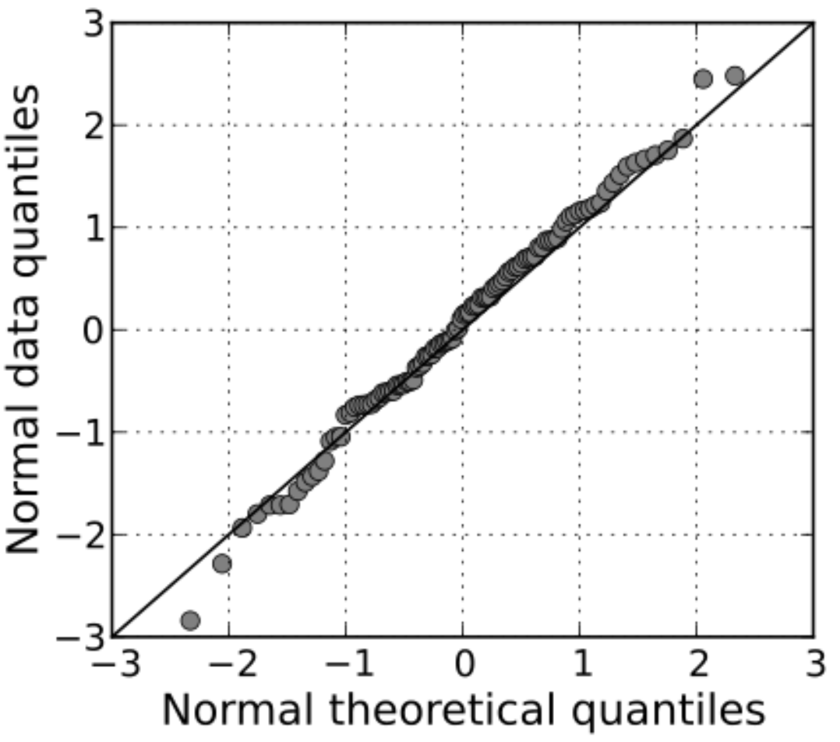
Exploratory data analysis
Correlation matrices
Source: Wikipedia Q-Q plot for Normal Distribution
Other:
Data quality assessment via data profiling
Hypothesis testing and associated statistical tests.
Dependent on type of data and problem!
Box-plots
https://towardsdatascience.com/an-extensive-guide-to-exploratory-data-analysis-ddd99a03199e
Notes:
This covers indicators that help you to exhaustively analyse your data. For instance, we might be interested in understanding the distribution of our data; this can include questions like is a specific feature in our data normally distributed? Or in a
classification scenario, are the target labels imbalanced? Etc. We might also be interested in assessing how different features are correlated with one another in our dataset.
Some examples here include:
1. Correlation matrices: These are matrices that identify how different features are related with one another and also with the target variable of interest. For a machine learning model, we would ideally like to remove redundant features, and this is where we can look at correlation matrices to remove features that are redundant or not too helpful for our model or combine features that are highly correlated into one. Correlation matrices are a powerful tool to summarize a large dataset and to identify and visualize patterns in the given data.
2. Quantile-Quantile plots: These help to identify if a particular feature in your dataset follows a normal distribution. Its important for you to know whether the distribution is normal or not so as to apply various statistical measures on the data and interpret it in much more human-understandable visualization . The normal distribution is symmetric and bell-shaped. This shape is useful because it can be used to describe many populations, from classroom grades to heights and weights. Normal distributions follow the 68-95-99.7 rule, which basically tells us how much of the data lies in the range of the first, second and third standard deviation from the mean. In addition to this, Q-Q plots can also reveal skewness of your data.
3. Box plots: Box plots are useful as they show the dispersion of a data set. Box plots visually show the distribution of numerical data and skewness through displaying the data quartiles (or percentiles) and averages. Box plots show the five-number summary of a set of data: including the minimum value of a feature, first (lower) quartile, median, third (upper) quartile, and maximum score. They can also quickly help to identify outliers.
In addition to this, Exploratory data analysis can also entail assessing data quality of your dataset to determine suitability for machine learning. This phase is critical for successful machine learning model development. Data quality checks can include looking for missing values, duplicates, feature value distribution, detecting outliers in dataset and various profiling statistics that can help you to further explore the distribution of your data. Once the underlying distributions of the data has been understood, we all apply various hypothesis and statistical tests to validate our understanding of the data. This can include statistical tests like sharipo wilk test to determine normality, analysis of variance (anova) test to compare variances across different groups etc. and identify statistical significances.
Choice of statistical tests and visualisations is data dependent and we encourage you to explore these further in your own time.

Slide 16
Feature Importance Indicators
Method | Explainability type
Intrinsic model parameters | Global
Permutation Feature Importances | Global
Partial dependence plots (PDP) | Global
Individual Conditional Expectation (ICE) | Local
Accumulated Local Effects (ALE) | Global
Masís, S. (2021). Interpretable Machine Learning with Python: Learn to build interpretable high-performance models with hands-on real-world examples. Packt Publishing Ltd.
Notes:
This entails answering questions like what matters most to the model and how much does it matter for it to make a decision?
Feature importance's include an array of methods that can shed light on the overall importance of features and how likely- individually or through combinations do they impact a model's outcome.
* For transparent models like decision trees and linear models, we can use the models' intrinsic parameters to determine which features are useful for the model to make predictions.
* In other cases, methods exist such as permutation feature importance (PFI) that can rank features by observing the increase in prediction errors through shuffling features in an iterative fashion.
* In addition to this, some other methods like the partial dependence plots (PDP) and Individual Conditional Expectation (ICE) help to visually investigate the relationship of a feature with a target variable by computing the marginal contribution (average for the former and individual for the latter) across all features.
* An improvement to these methods is feature importance via Accumulated Local Effects (ALE) which does not assume feature independence and helps to better visualise the importance of features with the target variable.

Slide 17
Bias
Many types of bias exist in the ML domain.
Some implementation available in the Fairlearn library.
Some metrics implemented include:
Demographic Parity (Binary classification)
Selection Rate (Binary classification)
Equalized Odds (Binary classification)
Error rate Parity (Binary classification)
Bounded Group Loss (Regression)
Notes:
Bias can be on many different levels, here we talk about biases associated with model generalisation that seek to avoid stereotypical harms, for example, a model you train should be fair on all cohorts of your population. We answer questions like: Is the model biased in its predictions towards certain cohorts, for example cohorts which are underrepresented etc?
For bias, we can initially look at the standard classification and regression metrics for each sub-group/cohorts of our population. This entails identifying groups with certain characteristics and then computing the classification/regression metrics for each of these sub-groups depending upon the problem statement. Additional fairness metrics include demographic parity, selection rate, equivalised odds for classification tasks and bounded group loss for regression. Bias in model can also be observed in a post-hoc manner by visually inspecting predictions for your cohorts. Defining fairness for these problems is still an on-going area for research.

Slide 18
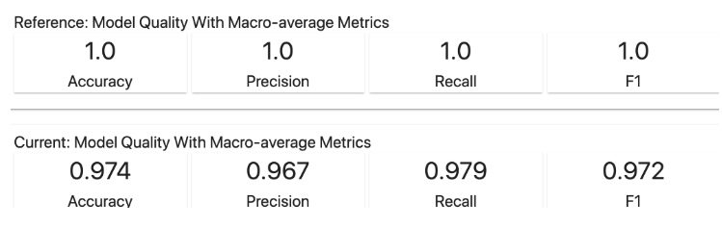
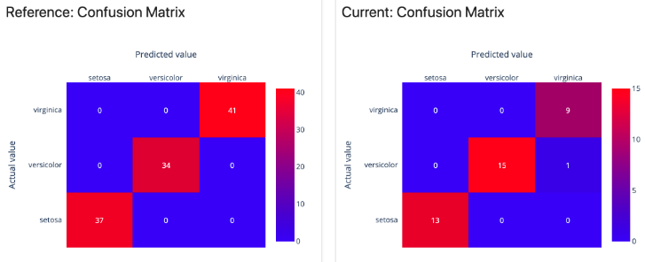
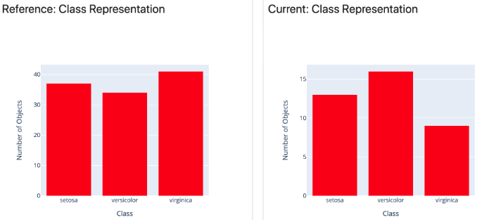
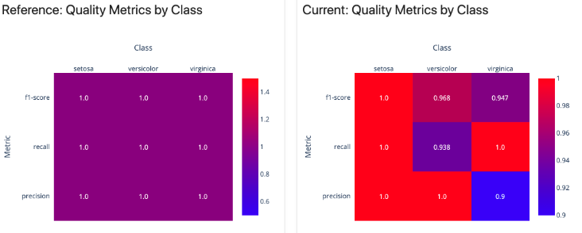
Production Monitoring – Model performance
https://docs.evidentlyai.com/reports/classification-performance
Notes:
This includes a selection of indicators that can help to assess the model performance. Here we are interested in answering questions like
how well does the model generalize to unseen data instances?
How much does the distribution of new unseen data vary with data distributions on which the model was previously trained on?
How much do predictions vary between current/re-trained machine learning model and an existing (benchmarked/reference) model that has previously worked well in production.
How much do predictions vary with respect to different features and target class distributions?
For evaluating model performance in a supervised machine learning context, there are standard classification and regression metrics available, that can quickly identify the model performance on your test data. For classification, the main metrics include accuracy, precision, recall, F1 score and confusion matrices- which are highly used to diagnose model performance. Precision (also called positive predictive value) is the fraction of relevant instances among the retrieved instances, while recall (also known as sensitivity) is the fraction of relevant instances that were retrieved. F1 is the harmonic mean of Percision and Recall. Two concepts implemented in the sklearn library include the macro and micro averaging for each of these metrics to monitor the performance for your classification model. The macro-averaging technique with these metrics is insensitive to the imbalance of the classes and treats them all as equal- giving more accurate reflection of the model performance on imbalanced datasets. For regression, the mean squared error, mean absolute error and R-squared statistic are used to determine the goodness of fit of the model to unseen data.
In this example, we can see some screenshots to monitor model performance from evidently AI- which is a platform designed to monitor machine learning models in production. This is a standard classification model example on the IRIS dataset. At the top left hand side, we see performance comparisons between the reference/benchmark model that has been previously trained with the current model. We also look at data distributions of the target variable. In order to further diagnose performance for the current model, on the right hand side, we see confusion matrixes and evaluation metrics by classes. A confusion matrix is a summary of prediction results on a classification problem. The number of correct and incorrect predictions are summarized with count values and broken down by each class. The quality metrics by class simply show percision, recall and F1 scores by each class.

Slide 19
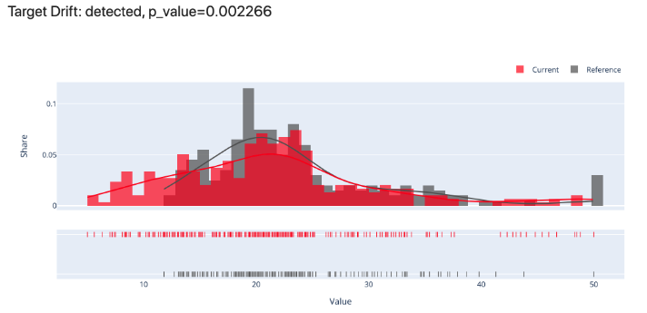
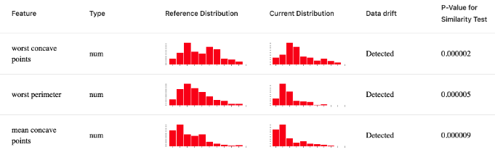
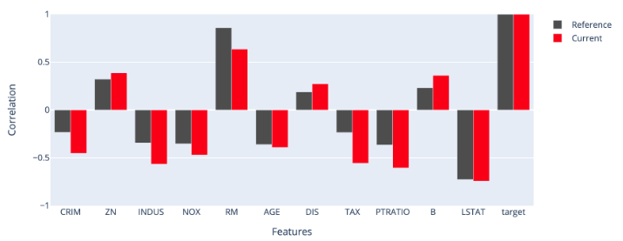
Production Monitoring – Data & Target drift
Data Drift
Target Drift
Target Correlations drift
https://docs.evidentlyai.com/reports/num-target-drift
https://docs.evidentlyai.com/reports/data-drift
Notes:
In addition to the above, when a model has been launched in production, it is important to monitor performance on unseen and new data instances. The indicators available here help to quantify data drift and target/concept drift. Data drift seeks to answer questions on how distribution of the features in the data vary by quantifying the similarity of the existing feature distributions with feature distributions that change when new data instances get added to the existing data. The dataset used as a reference to compare new data instances against is called the benchmark/reference dataset.
The Target/Concept Drift helps detect and explore changes in the target variable and predictions made by the machine learning model between the current dataset (with new data instances added) and a benchmark/reference dataset. Target drift helps to investigate change in predictive power of machine learning models. During training, the model learns a function that maps the target variable, but over time, it can unlearn them or is unable to use these patterns in a new and dynamic environment as more data samples are added- target drift helps to capture this. It can also be used to investigate the distributions of correlations between individual features and target variable. This can indicate how feature correlations change with the target variable as new data is available. Some tests that help to quantify the similarity between two data distributions include Kolmogorov–Smirnov (K-S) test, Chi-squared test, Z-test, Kullback-Leibler divergence, Jensen-Shannon distance, Population Stability Index etc. Evidently AI is a great platform for model performance management, incorporating all these metrics to in a dashboard format.
In this example we can see examples of data drift, target drift and change in feature correlations between our benchmark and current dataset. You would also notice that some of the statistical tests we mentioned earlier like the Z-test, Chi-squared test etc. quantify this drift and generate a number called the p-value. The p-value signifies statistical significance of results. A low p-value shows that the effect is large or that the result is of major theoretical or practical importance. Setting the thresholds to determine when a drift is significant is domain dependent.

Slide 20
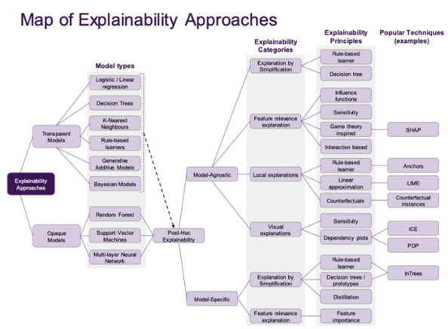
Model Explainability
Notes:
Indicators here answers questions on
How do I explain the decisions made by the model to different stakeholders?
How can we be confident in the predictions made by the model?
The indicators here come from different explainability methods that aim to :
Understand model behaviour locally - for each individual prediction
Understand the model behaviour globally (for the complete model).
Explainability can be grouped into two categories:
Transparent explainability
Posthoc explainability
Transparent explainability implies explainability for white box models. These rely on looking at model parameters intrinsically to draw conclusions. K-nearest neighbours, Decision Trees, Linear regression, Logistic regression are all white box models and we can look at the models intrinsic parameters to generate explanations.
Post-hoc explainability implies explainability after a model has been trained and applies to both white box and opaque/blackbox models.
This diagram here shows a map showing explainability approaches in XAI. Points to take away from this are:
* Transparent models like K-nearest neighbours, Decision Trees, Linear regression, Logistic regression are all white box models and we can look at the models intrinsic parameters to generate explanations.
* Transparent models can also be evaluated in a post-hoc manner.
* Explanations for Opaque/black box models like Random forest, Support Vector machines, neural networks are evaluated in a post-hoc manner.
* The post-hoc approaches in explainability can be both model specific and model agnostic.
* Some model specific approaches include Integrated gradients, tree SHAP, Linear SHAP, Deep SHAP.
* Some model agnostic techniques include Individual Conditional Expectation (ICE), Partial dependence plots (PDPs) which we looked at earlier, peturbation based methods like, Shapely values, LIME, Anchors, Kernel SHAP, Paritition SHAP, Counterfactuals etc.
* Most of these approaches like Shapely, SHAP, have solid mathematical foundations in cooperative game theory that make them a reliable model interpretability method.

Slide 21
Summary
XAI is important and mandatory in many countries.
Explainability requirements depend on your end user and aims
Implementation is a co-design process with the users
Different indicators exist to evaluate your data and ML performance
Justifiability, accountability and explainability considerations as part of ML model development allow a transparent ethical workflow.

Slide 22
Any Questions?

Slide 23
Lesson 2

Slide 24

Case study: CESIUM
CESIUM is a tool used by safeguarding professionals to help combat child exploitation
CESIUM allows the user to explore the key aspects of vulnerability for a child through data visualisations and insights from various models to support professional decision making
CESIUM augments professional judgement with evidence-based insights for safeguarding decision-making
Notes:
Brief demo – emphasise the value and importance of co-design within explainability

Slide 25
CESIUM: DEMO
Notes:
CESIUM demo on insights page – shap feature importance
Demo a person with a high score and explore why, etc

Slide 26
CESIUM: Explainability Requirements
Who?
Safeguarding professionals at Lincolnshire police and children's social care. Intelligent and engaged. No technical background. Familiar with percentiles, quantifying risk via numbers or colours. Not familiar with machine learning algorithms, histograms
What?
End users are very familiar with the dataset
Technical details of the model not necessary
Need to know why is an individual insight is important
How?
Prioritise and review cases of potential child exploitation risk
Help guide which children might be important cases to review
Support a case review of an individual by providing insights and reasoning
Users have very limited time

Slide 27
Exercise 1: presenting the result
Firstly, we need to state what question the model trying to answer and what is the result
Suppose John Smith has a model output of 0.78 (which is the 95th percentile)
Discuss the relative merits of the following presentation of this result
John Smith has a model output of 0.78
The likelihood for John Smith to be involved in a MACE meeting is 0.78
John Smith is in the top 5% of children for referral to MACE
John Smith is in the 95th percentile of children for referral to MACE
How likely is John Smith to be involved in a MACE meeting at this time?
Notes:
Possible discussion points
Using the phrase ‘model output’ does not contextualise the result for the end user
Using the output of the model does not provide a comparison of the result compared to other people that the police need to prioritise against.
The end user is interested in which children they should focus their time and resources on, as such as score relative to other children would be more beneficial to their operations. Does the model output have any operational value in isolation?
It is useful for big numbers to mean higher risk.

Slide 28
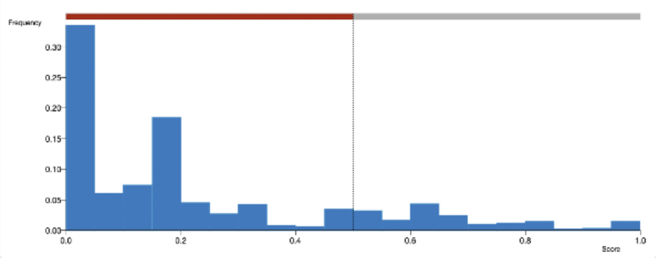
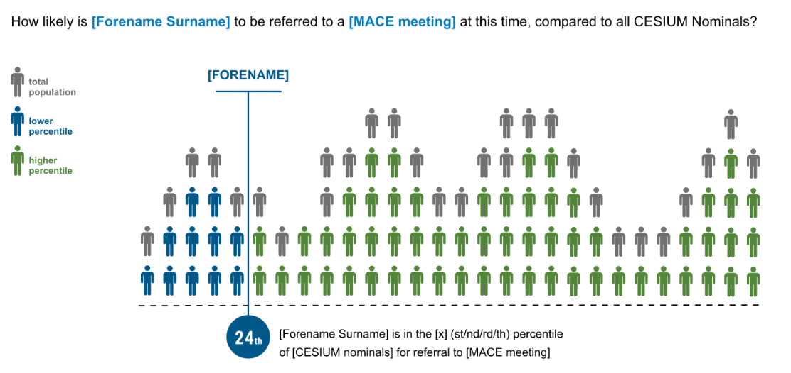
Exercise 2: visualising the result
Gives a multi-model approach to the explainability and allows end users to understand the result in different ways
Providing a visualisation helps to make it obvious that we are comparing an individual's score to all other children and the result corresponds to their position
Discuss the relative merits of the two different designs of visualisation
Notes:
Possible discussion points:
End users not comfortable with histograms
Pictograms are more common in everyday life
Pictogram connects the fact that the area represents people
Colour helps clarify the point
Statement on the visualisation helps make the point

Slide 29

Exercise 3: why was a sentence flagged
Aim: identify text containing potential sexual and violent content to make it easier and quicker for the reader to identify vulnerability to the child
Discuss the relative merits of explaining the results of a text classifier using
visual explainability (a bar chart to give relative importance of each word)
textual explainability (a sentence listing the 3 most important classifying words in the sentence).
Notes:
Possible discussion points:
Bar chart has more detail – it is a more complete explanation
As we discussed before, it is not about giving the most amount of explanation, but giving it at the right level
Textual explanation is much more intuitive and easier to understand
A bar chart for each sentence can be confusing and overwhelming
Textual explanation provides the most important information succinctly
Textual explanation does not give the whole picture

